Slide 1
Cloud Networking
Using AWS

Slide 2
Welcome!
Agenda:
1st session
Morning Tea
2nd Session
Group Photo
Lunch
3rd Session
Afternoon Tea
4th Session
Wrap-Up

Slide 3
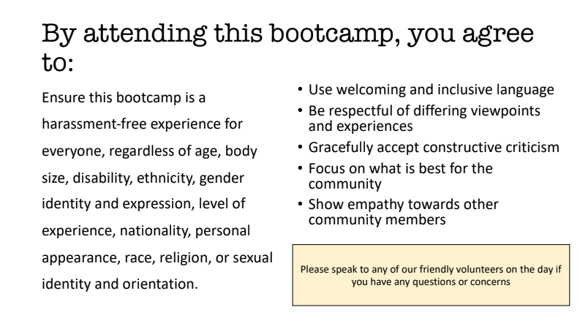
Code of Conduct

Slide 4
Logistics Check List
Toilets
Water/Coffee/Tea
Building Access
Fire Evacuation

Slide 5

Why are you here today?
Let’s discuss in our groups
Image sourced from: https://broadlygenderphotos.vice.com/

Slide 6
Thank you for your sponsorship and providing a location and food

Slide 7
Thank you for your sponsorship and providing AWS account credits

Slide 8


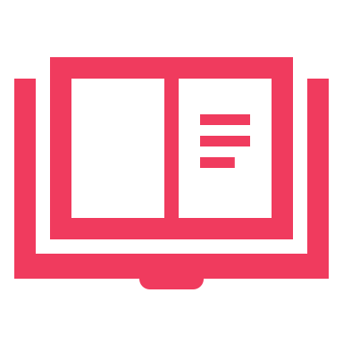
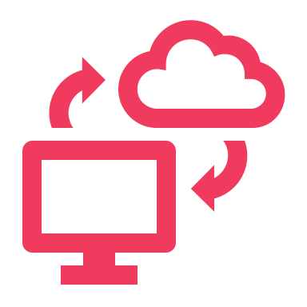


Two Modes of Learning
Theory
We’ll introduce you to some concepts and answer questions
Hands On
We’ll jump into the AWS console and start creating our cloud networks

Slide 9
Networking Intro
Virtual Private Cloud (VPC)
CIDR Range
Subnets
Internet Gateway (IGW)
NAT Gateway
Direct Connect/VPN
VPC Peering
Route Table
Network Access Control List
Defines where network traffic can go
Isolated part of the cloud of your AWS services
Connecting VPCs
Connects your VPC to the internet
Securely connect a private subnet to a public subnet
A subset of your VPC
Securely connect your VPC to on-prem infra
Set of rules to block/allow inbound/outbound network traffic
Determines number of IPs your VPC can have

Slide 10
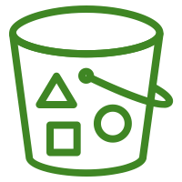
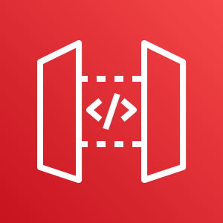
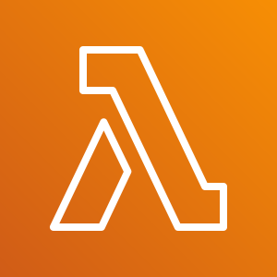
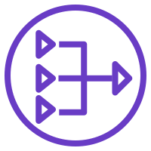
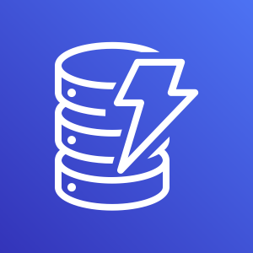
What you will create today
Private Subnet
Public Subnet
Internet
NAT Gateway
Route Table

Slide 11
Pit Stop – CIDR Ranges
/x is the size of the bytes
VPCs - between /16 and /8
Subnets - between /16 and /28 (CIDR blocks of the subnets cannot overlap)
AWS’s 5 reserved IPs:
Network address
VPC Router
DNS Server
‘future use’
Network Broadcast address
Subnet CIDR range cannot be the same or larger than the VPC
Let’s head to: http://cidr.xyz/
Classless Inter-Domain Routing

Slide 12
VPC, Subnets, IGW, Route Table, NAT Gateway
Head to the GitHub Repo and let’s create this!
Private Subnet
Public Subnet
Internet
Route Table
NAT Gateway

